Slide 1
Sterling E-commerce Sales Data Analysis
10ALYTICS Group 4 Data Science Team
Members:
Falugba Mobolaji
Ogwuche Abraham
ChiDIiMma IDIKA
Chidiebere CHUKWNARU
Edward AGUN
Cletus ABHULIMHEN

Slide 2
Introduction and objectives
Sterling E-Commerce is a one-stop online shopping destination for a wide range of high-quality products. Their mission is to provide customers with the best shopping experience possible, with a focus on quality, affordability, and convenience.
They want to understand their data, so they can optimize their product offerings, streamline operations, and enhance Sterling’s customer experience.
An Online Sales data for 2021 and 2022 was provided for this analysis.

Slide 3
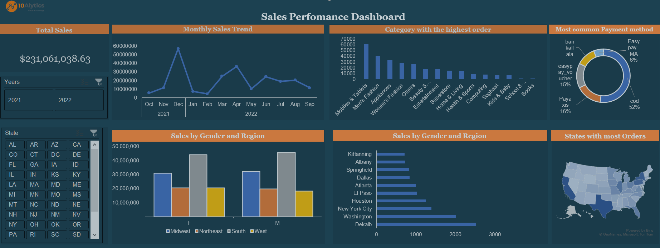

Slide 4
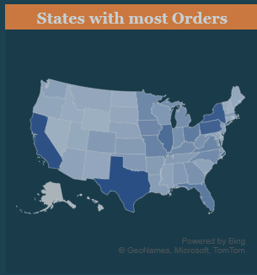
Sales by Geographical Analysis
The city with the highest number of orders is Texas with 17,510 orders, while the city with the lowest order is Rhode island with 492 orders.
The city with the highest sales is Texas with $15,467,455 orders, while the city with the lowest sales is Rhode Island with $305,838 orders.
The Region with the highest sales is Midwest with $62,920,632, while the Region with the lowest sales is West with $38,528,310

Slide 5
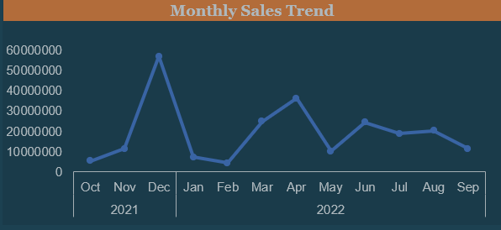
Sales by Category and Monthly sales Trend
The most popular product category is the Mobile and Tablets with 60,952 orders while the least was Books with 804 orders.
The highest sales were recorded in December 2021 which immediately followed a sharp decline in January 2022 with the lowest trough in February 2022.

Slide 6
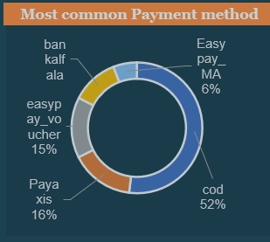
Payment Analysis
The method of payment that was most common with customers was Cod with 101,750 transactions while the least was Jazzeouchei Jazzwallet with just 1 transaction.

Slide 7
Customer Experience and Recommendations
Increase stock for popular products: Identify the top-selling products and ensure sufficient inventory is available for them, especially during peak seasons, to avoid stockouts and maximize sales opportunities increase marketing of products with low sales.
Optimize staffing in cities with unusually high amount of orders
Enhance online sales channels. Invest in improving the online shopping experience, website performance, and digital marketing to attract more customers and increase online revenue.

Slide 8
THANKS FOR LISTENING

